Slide 1
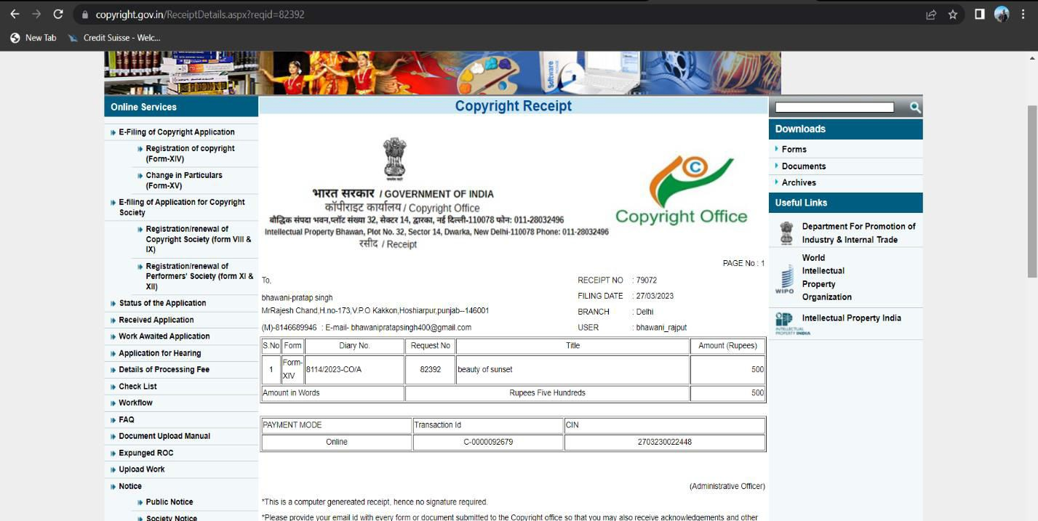
INT 301 CA2
TITLE: BEAUTY OF SUNSET
CATEGORY: ARTISTIC
DIARY NUMBER: 8114/2023-CO/A
GitHub : https://github.com/aryansoni621/Sunset-Serenade
SECTION-KE016
Name (PI) - Aryan Soni Group No-02
RegNo-11915538
Roll No-B64
Name(CO-PI)- Bhawani Pratap Singh Group No-01
RegNo-11906195
Roll No-A17

